Slide 1
WEBKDD 9th, SNAKDD 1st
Company LOGO
Automated Social Hierarchy Detection through Email
Network Analysis
報告人: 陳品諺

Slide 2
About this paper…
Company LOGO
Link Mining
Email Social Networking
Social Score
Result/Discussion/Conclusion

Slide 3
Link Mining
Link mining is a set of techniques that uses different types of networks and their indicators to forecast or to model a linked domain.
Notes:
1.Link Mining是使用不同類型的networks跟指標 去預測 或者 去模擬一個連接的domain,的一組技術

Slide 4
Related with Link Mining
Money laundering¹⁷
Telephone fraud detection ⁹
crime detection³⁰
surveillance of the NASDAQ^{17,13}
Notes:
1.洗錢,一種情況是利用金錢流動情形去推論,或者
2.電話詐騙,甚至有學者把一些電話詐騙的case從結果論去看,發現線索早已淺再在通聯的紀錄裡面。
3. 透過一個人sociality,crime detection..etc
4.NASDAQ納斯達克是美國的一個電子證券交易機構,監督NASDAQ,監督有無非法交易行為,有無違反證卷交易法之類的

Slide 5
Email Social Networking

Slide 6
Data Set
Over 600k emails from 150 users
User
Inbox
From whom
Time info
Sent Box
To whom
Contact
Content
Time info
Content
User info
User name

Slide 7
Goal
Pick out the most important individual(s) in an organization.
Group individuals with similar social/email qualities.
Graphically draw an organization chart which approximately simulates the real social hierarchy.
Notes:
1.在這個email social networking 中找到最重要的個體
2.群體之間的email的相關屬性的相似度,這個group的流通mail的量,跟其他group的流通mail的量..etc
3.畫圖,visualization,並階層化,hierarchy

Slide 8
Communication Networks
No useless information in our processing
email threshold N is first decided on
We then employ a clique finding algorithm, Algorithm 457,proposed by Bron and Kerbosch².
Notes:
1. An undirected edge is then drawn between each pair of accounts which have exchanged at least N emails.
2. Step 1. Selection of a candidate.
Step 2. Adding the selected candidate to compsub.
Step 3. Creating new sets cundidutes and /lot from the old sets by removmg all pomts not connected to the selected candidate (to remain consistent with the definition), keeping the old sets in tact.
Step 4. Calling the extension operator to operate on the sets just formed.
Step 5. Upon return, removal of the selected
第1步：選擇候選人。
第2步：添加所選候選人compsub。
第3步：由removmg沒有連接到所選候選人（保留的定義一致）所有pomts，保持舊有機智創建新組cundidutes和/手從舊套。
第4步：調用擴展運算符對剛剛形成的集合操作。
第5步：返回後，去除選定

Slide 9
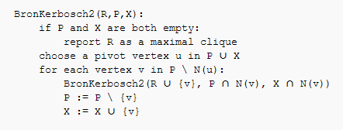
Bron–Kerbosch algorithm
R : current clique
P : pending vertices set
X : already visited vertices set
rrRandom
Max weighted degree
Max weighted clique
Notes:
algorithm 457中的with pivot方法,recursively 呼叫這個方法, 窮舉所有的Maximal clique
R是目前的clique
P是可以增大目前clique的點集合。接下來要列舉的點。
X: 可以增大目前clique的點集合，但是先前已經列舉過。用來避免重複列舉。

Slide 10
cliques
Number of cliques
Raw clique score
R = 2^(n-1), where n is the node number
Weighted clique score
W = t * 2^(n-1), where t is the time score and n is the node number
Notes:
2. 是對於size來說,這個clique score是多少
3. This preliminary“importance” is computed strictly from the number of emails and the average response time.
Each account in a clique is given a weight proportional to its computed preliminary.
Then add this time weighted to raw clique score
T是response score
可看成,對於回復時間來說,這個clique socre是多少

Slide 11
Social Score

Slide 12

Distribution
number of emails
clustering coefficient
average response time
Mean in all pair
response score
number of cliques
Hubs-and-Authorities
raw clique score
degree centrality
weighted clique score
Betweenness centrality
Notes:
Inf x是所有user中該socre最低的分數,sup x則反之,所以每個user會有這11種分數
對於number of emails來說,當他帶入這公式之後,所得的結果是相對於整個social networking的score

Slide 13
Score Distribution
number of emails
clustering coefficient
average response time
Mean in all pair
response score
number of cliques
Relate to email exchange and avg response time
Hubs-and-Authorities
raw clique score
degree centrality
weighted clique score
Betweenness centrality
Notes:
1.並沒說怎麼算的,只知道從avg res time得到,User回復信件的分數,這篇paper是採用greedy做法,也就是越快回復越重要,ie.avg response time越低,response score越高,
是個0~1的值,由此user的avg response time相對於整體user的強度

Slide 14
Score Distribution
number of emails
clustering coefficient
average response time
Mean in all pair
response score
number of cliques
Hubs-and-Authorities
raw clique score
degree centrality
weighted clique score
Betweenness centrality
Notes:
跟page rank算法應該是一樣的

Slide 15
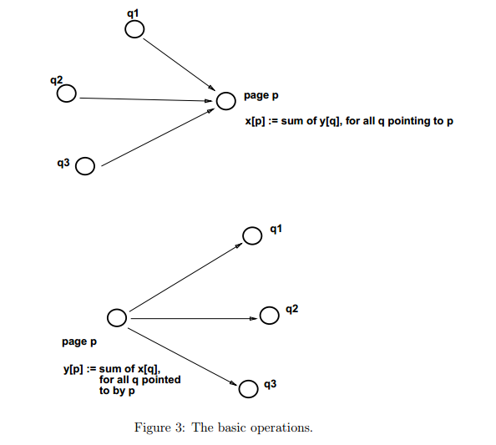
Score Distribution
Hubs
number of emails
clustering coefficient
average response time
Mean in all pair
Authorities
response score
number of cliques
Hubs-and-Authorities
raw clique score
degree centrality
weighted clique score
Betweenness centrality
Notes:
1.Hubs:別人傳送給你eamil 你所得到的相對分數, Authorities :你傳送給別人email 你所得到的相對分數
跟page rank算法應該是一樣的

Slide 16
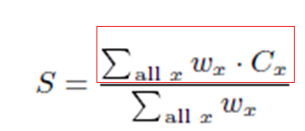
11 attributes in each node
Notes:
1.最後,normalized,得到的Social score 是一個100分為滿分的分數
基於上面那個公式,可以得到11個相對於整個social networking的相對分數,再用這個公式得到一個相對於這個social networking的social score

Slide 17
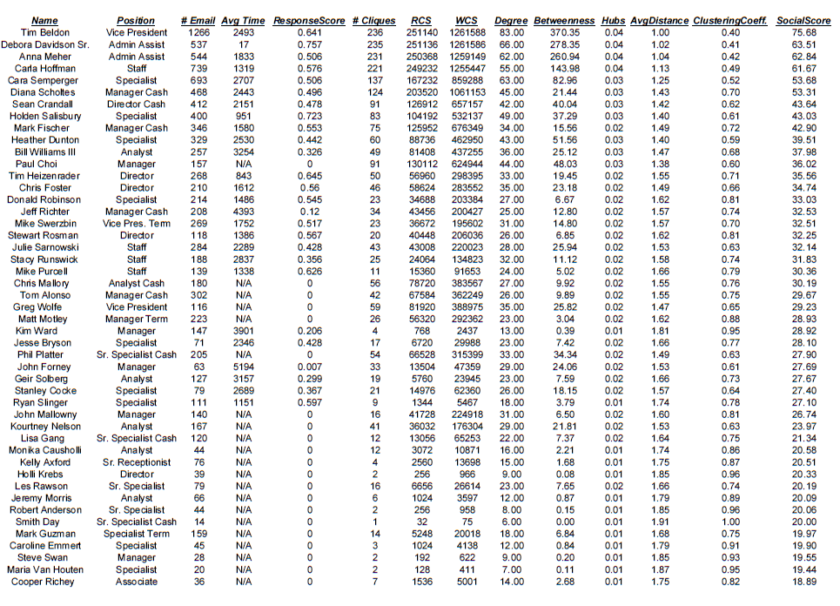
Result

Slide 18
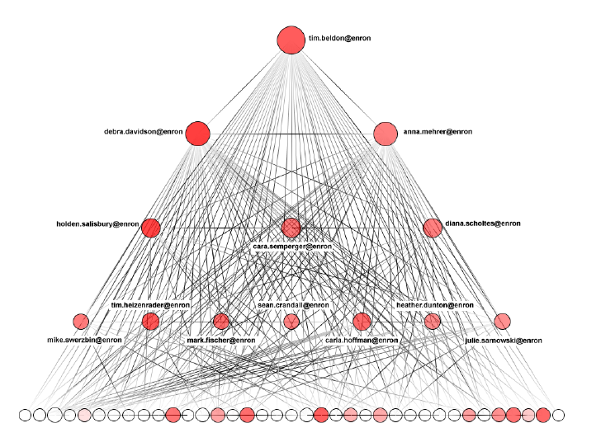
Visualization
Set parameter of echelons to 5

Slide 19
Discussion/Conclusion
Social Score relates to work position.
In the same layer, more similar mail content, mail activity especially lower layer.
The most important 2 or 3 individuals in each layers except the top one.
Evaluate our algorithm and offer the solution.
Notes:
1.在同一層中,mail相似度高,特別是越底層
2.每一層中都有兩個或三個核心的個體,除了最頂層以外

Slide 20
Evaluation
Apply this algo on North American West Power Traders division of Enron Corporation
Parameter of echelon
Different data different distribution
Response time
t1t
B
A
t2t
C
Notes:
1.To the NAWPT is 3(echelon coefficient),階層效果會比較顯著,Enron企業的北美西電力交易部門
2.針對response time做出探討

Slide 21
Evaluation
Apply this algo on North American West Power Traders division of Enron Corporation
Parameter of echelon
Different data different distribution
Response time
t4t
B
A
t3t
C
t1t
B
A
t3t
B
A
t2t
C
t4t
C

Slide 22
Evaluation
Apply this algo on North American West Power Traders division of Enron Corporation
Parameter of echelon
Different data different distribution
Response time
t4t
B
A
t3t
C
t1t
B
A
This paper assuming quickly reply is more important
t3t
B
A
t2t
C
t4t
C
Notes:
3.這篇paper並不在乎哪個才是真正重要,只取最快速回復的那個,他也說這會有bias,有可能只是這個使用者,只是剛好看到這封剛寄來的信
或者習慣從最近的時間點開始回復信件,也有可能是因為user A和user B或 user C有不同的work schedule
那我們如何得知?

Slide 23
Final project proposal
Implement this paper and updating the response score object function
Pick out the most important individual(s) in an organization.
Transform static community to dynamic one.
Networking transition Process

Slide 24
Improvement
Response time
Replace the average response time to statistical method.
Consider different people maintaining different work schedules.
Update response score function
Notes:
1.就統計A user回復信件的紀錄,若往往都是以先看到先回復的話,那就可以採用原本的quickly replying 計算方式
不然就去看A回復給B的紀錄,利用統計方式得知A是怎麼看到B所寄來的信件的(也就是說重要強度是如何)
Rather than implementing the straight scale division algorithm, a more statistically sophisticated formula can be used to group users by percentile or standard deviations of common distributions.可以利用cliques的資訊去adjust,如相同的cliques有相同的work schedules的強度是如何。

Slide 25
Transform Static To Dynamic
Model the dynamic social network as a sequence of graphs {G₁,G₂, ...,G_{n}}, where G_{i} = (V_{i}, E_{i}) represents a graph with only the set of individuals and interactions at a particular snapshot i.
Apply static community mining algorithm at any snapshot.

Slide 26
Dynamic Community Analysis
Form
A community C_{i}^{p} forms at ith snapshot if there is no community match for it in any of the previous snapshots.
Dissolve
A community C_{i}^{p} dissolves at ith snapshot if there is no community match for it in any of the next snapshots
Survive
A community C_{i}^{p} survives at ith snapshot if there exists a snapshot j > i that contains a community match for C_{i}^{p}
Notes:
1.形成
2. Dissolve溶解

Slide 27
Dynamic Community Analysis II
Split
The community split into one or more than one communities .
Merge
Merge this two community

Slide 28
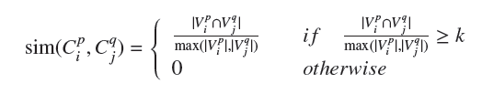

Match Algorithm
Change similarity object function to:
where k is similarity threshold related to social score
If != 0,then the maximum weight bipartite matching is applied to connect communities at time t to communities at time t − 1.
Notes:
2.T時間點跟t-1時間點的social networking成雙分圖
If community Cp t matches to community Cq t−1, then we can say that Cp t is the survival of Cq t−1 (i.e. Cq t−1 survives to Cpt ).

Slide 29
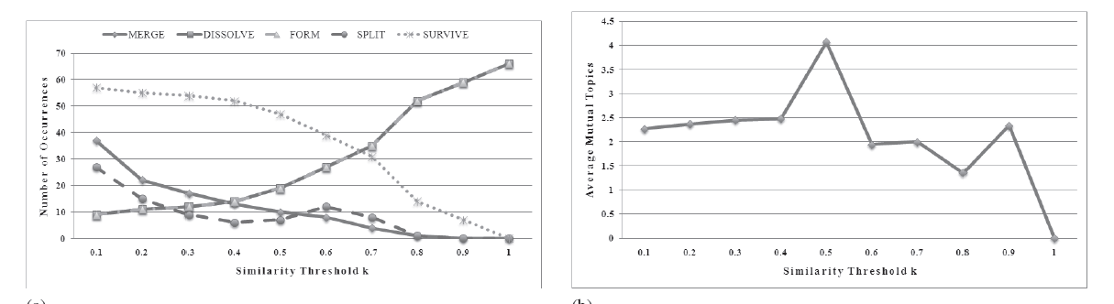
The average mutual topics is between any two survival communities during the observation time.
Notes:
2. The average mutual topics between any two survival communities during the observation time for different similarity thresholds

Slide 30
Reference
Automated Social Hierarchy Detection through Email Network Analysis
Mining Periodic Behavior in Dynamic Social Networks
Community Evolution Mining in Dynamic Social Networks.

Slide 31
Goes further
Mining Periodic Behavior in Dynamic Social Networks
Distributed Computing Environment
Google Engine
Amazon Server
Better Solution to primary problem

Slide 32
Thanks for your attention
ANY COMMENT ?

